Slide 1


AI-Powered Mental Health Monitoring and recommendation System
PUNE DISTRICT EDUCATION ASSOCIATION’S COLLEGE OF ENGINEERING
Manjari (BK), Pune - 412307 (Maharashtra) India
**NAAC Accredited**
DEPARTMENT OF COMPUTER
ENGINEERING

Slide 2
Team Members:
Shubham Kamble(BA-55)
Shlok Ekhande(BA-29)
Sagar Ingole(BA-41)
Roshan Jayabhaye(BA-52)
Project Guide: Prof.A.A.Bamanikar

Slide 3
Introduction:
Mental health is a vital part of overall well-being, but early detection and support are often limited. This project aims to use AI to monitor emotions and provide personalized recommendations to help improve mental well-being.

Slide 4
Problem Statement:
Mental health issues often go unnoticed due to lack of early detection and support. People may not realize changes in their emotional state until it affects their daily life. There is a need for a system that can monitor mental health, detect emotions in real time, and provide recommendations to maintain well-being.

Slide 5
Objectives:
To collect and analyze the user’s daily text input using NLP and ML techniques to accurately detect and classify emotions.
To provide personalized recommendations and guidance based on the identified emotional state to support users’ mental well-being.
To securely store emotional data for tracking and future analysis, ensuring user privacy and data integrity.
To generate meaningful emotion trend charts that help users understand their emotional patterns over time.

Slide 6
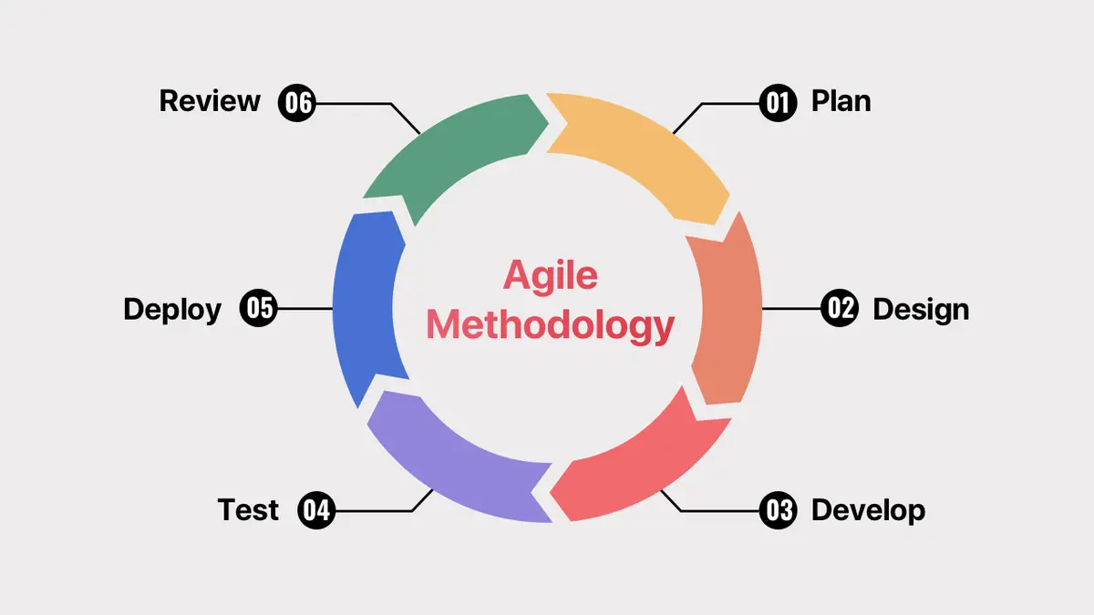
SDLC (Software Development Life Cycle)
We are following the Agile model by working in small sprints, each focusing on tasks like model development and backend features. After every sprint, we test the current progress and make improvements based on feedback. This iterative approach helps us continuously refine the emotion detection system as the project is still in development.

Slide 7
Software Requirements Specification (SRS)
Scope:
To analyze user-entered text using NLP and classify emotions.
To provide emotion-based personalized recommendations.
To store user emotion data for future reference
To generate monthly emotion charts for overall emotional analysis.
To offer a simple and user-friendly interface.
The system focuses only on text-based emotion detection, not voice or medical diagnosis.

Slide 8
Functional Requirements
Accepts user text input for emotional analysis.
Preprocesses the text using NLP techniques.
Detects and classifies the user’s emotion.
Generates recommendations based on emotion.
Stores emotion results for monthly analysis.
Creates emotion charts for users.
Displays all outputs through a simple, interactive UI.
Handles empty or invalid inputs gracefully

Slide 9
Non Functional Requirement:
System responds quickly to input.
Interface is simple and user-friendly.
Application works smoothly without lag.
User text data remains private.
Emotion detection gives good accuracy.
System runs reliably during usage.
Easy to modify and maintain.

Slide 10
System Requirements:
Software Requirements:
Language: Python
Libraries: NLTK, Scikit-learn, Pandas, NumPy
Backend / Frontend: Flask, HTML/CSS
Database: SQLite
Hardware Requirements:
Processor: Intel i5 or equivalent – run Python & AI smoothly
RAM: 8 GB – handle datasets & training
Storage: 256 GB SSD – store files & datasets
Internet: Needed to download datasets & libraries

Slide 11
System Design:
Modules:
Frontend – Collects input from the user.
Backend– Processes input and communicates with AI Model and Database.
AI Model & Recommendation – Predicts emotions from user text and give suggestions based on emotion.
Database – Stores user input, predictions, and recommendations.
Visualization – Displays charts and dashboards.

Slide 12
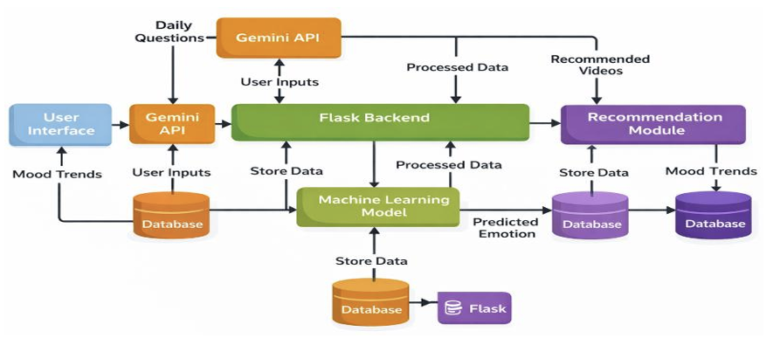
System Architecture:

Slide 13
Implementation:
Week 1:
Overview:
In Week 1, we started the project implementation, finalized the tools and technologies, collected the dataset, and designed the basic workflow of the system
Discussions Done This Week:
Discussed the tools and technologies to be used
Discussed how the system will work
Planned how to prepare and clean the data
Discussed how the model will detect emotions
Planned the next steps for development

Slide 14
Implementation:
Installed Python for development
Set up development environment using VS Code
Installed required libraries
Verified installation of all required packages
Set up basic project folder structure
Designed the initial system workflow
Planned and started setup for external APIs
Conclusion:
Successfully set up the development environment
Completed initial project setup and workflow design
Prepared the system for further development in upcoming weeks

Slide 15
Week 2:
Overview: In Week 2, we focused on working with the dataset and performing text preprocessing to prepare the data. We also started building and training the machine learning model. This phase marked the transition from initial setup to actual implementation of the system.
Discussions Done This Week:
Discussed how to clean and prepare the data
Explored different ways to convert text into usable form
Discussed model building approach
Reviewed initial model performance
Planned next steps for improvement

Slide 16
Implementation:
Loaded and explored the dataset
Performed text cleaning and preprocessing
Removed unwanted words and characters
Converted text data into numerical format
Split data into training and testing sets
Started building and training the model
Conclusion:
Data preprocessing completed
Model building started
Initial training process initiated
Ready for further improvement

Slide 17
Week 3:
In Week 3, we focused on building and training the machine learning model using the preprocessed data. We worked on implementing the model and generating initial outputs. This marked the beginning of the core functionality of the system.
Discussions in This Week:
Discussed how to build the model using processed data
Explored suitable algorithms for emotion detection
Reviewed initial outputs of the model
Discussed ways to improve accuracy
Planned next steps for integration

Slide 18
Implementation:
Applied TF-IDF to convert text into numerical form
Built the machine learning model
Trained the model using dataset
Tested model with sample inputs
Generated initial predictions
Conclusion:
Model building completed
Initial training performed
Basic predictions generated
Ready for improvement and integration

Slide 19
Week 4:
Overview:Started backend development to build the core structure of the application.
Discussions:
Selected Flask
Planned ML model integration
Defined input → prediction flow
Decided routing structure
Identified required tools

Slide 20
Implementation:
Setup Flask structure
Loaded model and vectorizer
Added preprocessing logic
Created routes: /, /login, /register
Organized backend code
Conclusion:
Backend initialized
Basic routing ready
Model ready for integration
Structure prepared
Ready for next phase

Slide 21
Week 5:
Overview:Focused on implementing database and user authentication to manage user data securely..
Discussions:
Planned user data storage and security
Selected SQLite
Designed tables (users, mood history)
Decided login/register flow
Considered password security

Slide 22
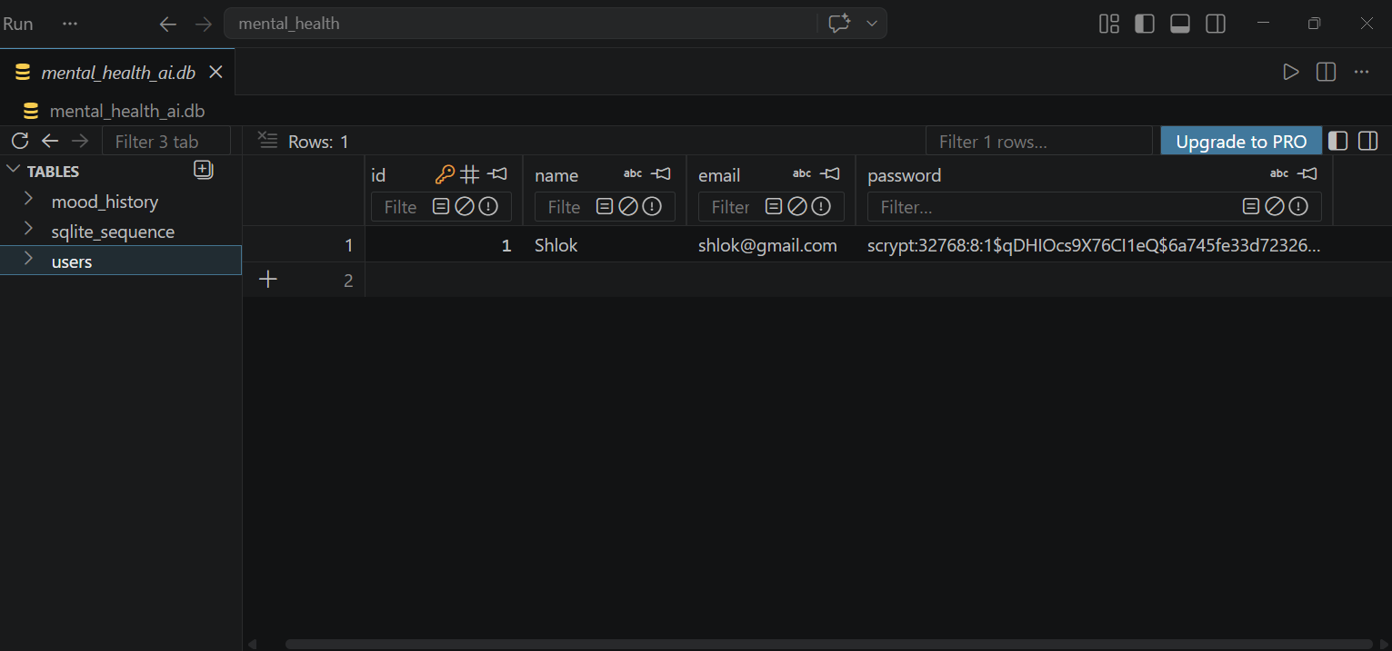
Implementation:
Created database and tables
Implemented registration system
Added login functionality
Applied password hashing
Managed user sessions
Conclusion:
Database successfully integrated
Authentication system working
User data securely stored
Backend strengthened
Ready for frontend integration

Slide 23
Week 6:
Overview:Focused on developing the user interface and connecting it with the backend.
Discussions:
Planned user interface design and navigation
Decided required pages (home, login, register, dashboard)
Defined form handling between frontend and backend
Focused on user-friendly design
Planned integration with backend routes

Slide 24
Implementation:
Created HTML templates (home, login, register, dashboard)
Designed forms for user input
Connected templates with Flask routes
Implemented data flow from frontend to backend
Tested basic frontend-backend interaction
Conclusion:
Frontend successfully developed
Templates integrated with backend
User interaction enabled
System became interactive
Ready for model integration

Slide 25
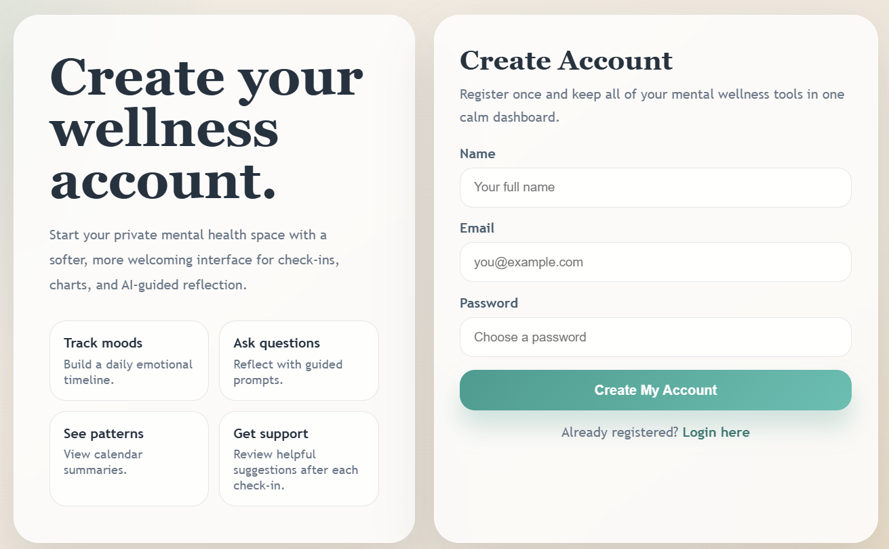
Register Page:

Slide 26
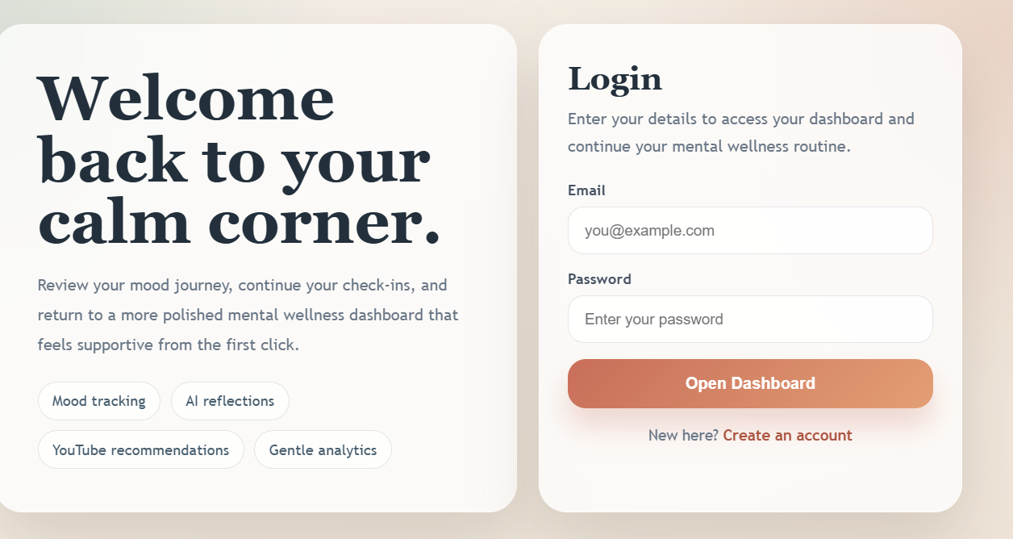
Login Page:

Slide 27
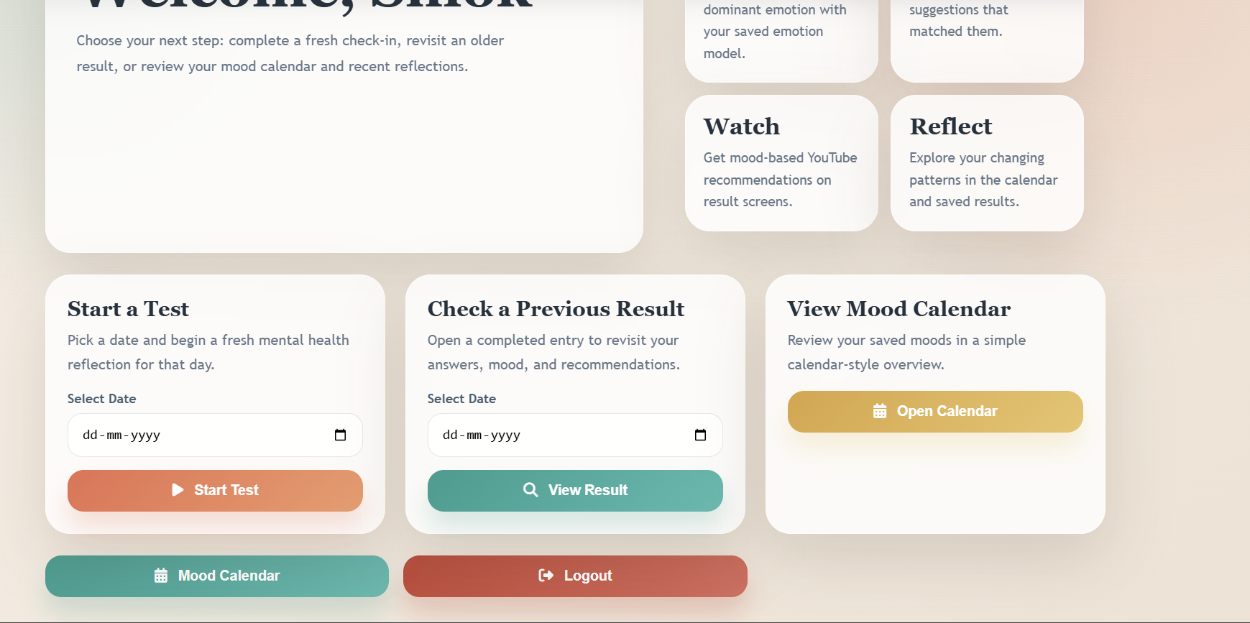
Home Page:

Slide 28
Week 7:
Overview:Integrated the trained ML model with the backend to enable emotion detection.
Discussions:
Planned connection between user input and ML model
Defined preprocessing and prediction flow
Considered handling invalid or empty input
Decided fallback mechanism for reliability
Planned output format

Slide 29
Implementation:
Integrated model and vectorizer with backend
Processed user input using preprocessing functions
Implemented mood prediction logic
Added fallback rule-based detection
Connected prediction result with frontend
Conclusion:
Emotion detection working successfully
Model integrated with system
Reliable prediction achieved
System functionality improved
Ready for feature enhancement

Slide 30
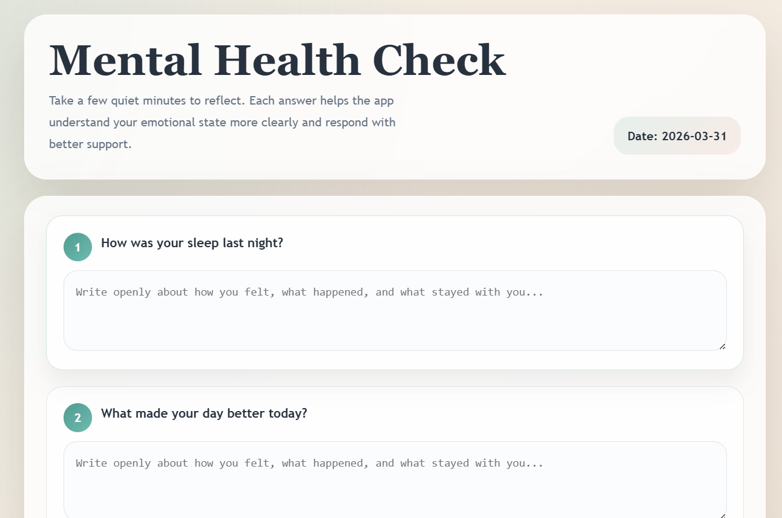
Test UI:

Slide 31
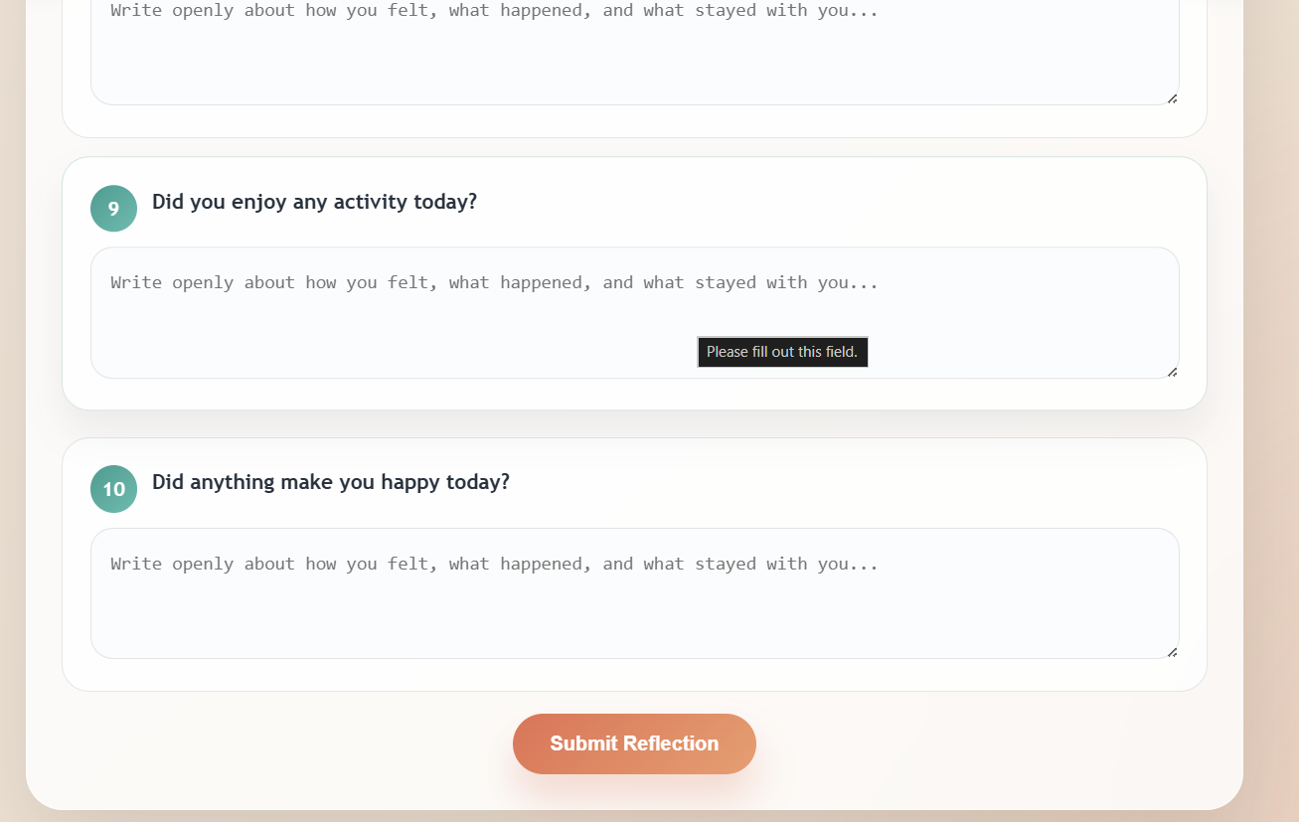
Test Submission:

Slide 32
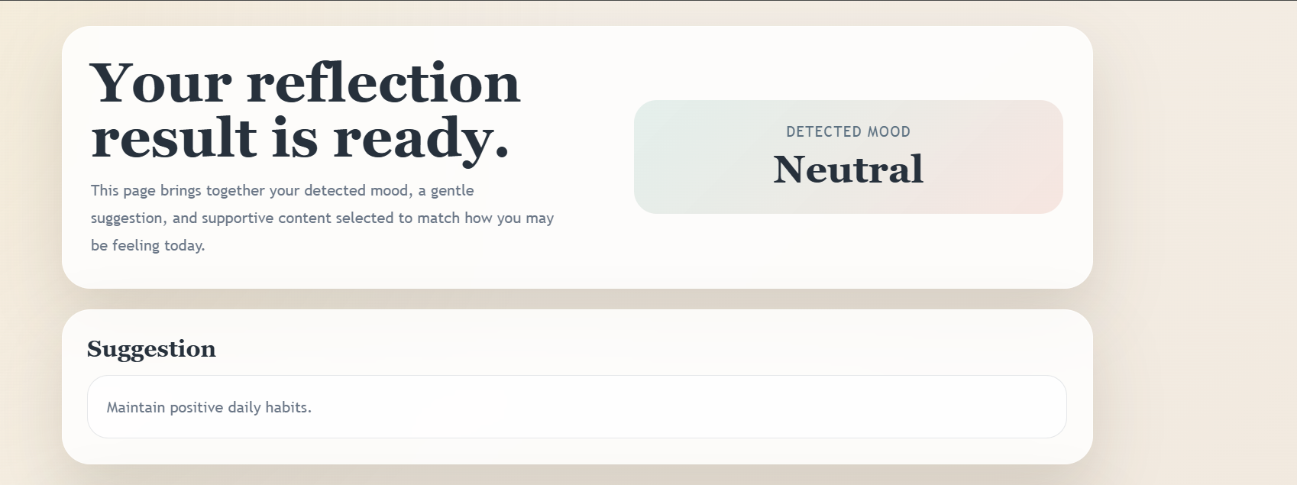
Mood Prediction:

Slide 33
Week 8:
Overview:Focused on implementing core features and integrating them with the backend system.
Discussions:
Planned mood-based output and user interaction
Decided to store user test results
Planned recommendation system based on mood
Considered tracking user history
Focused on improving functionality

Slide 34
Implementation:
Stored mood history in database
Implemented mood-based suggestions
Integrated YouTube API for video recommendations
Developed mood calendar feature
Added previous test checking functionality
Core features successfully implemented
Backend functionality enhanced
User data tracking enabled
Recommendation system working
System ready for further improvements
Conclusion:

Slide 35
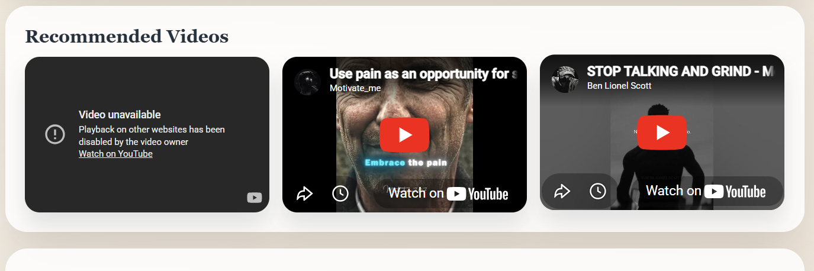
Recommendation:

Slide 36
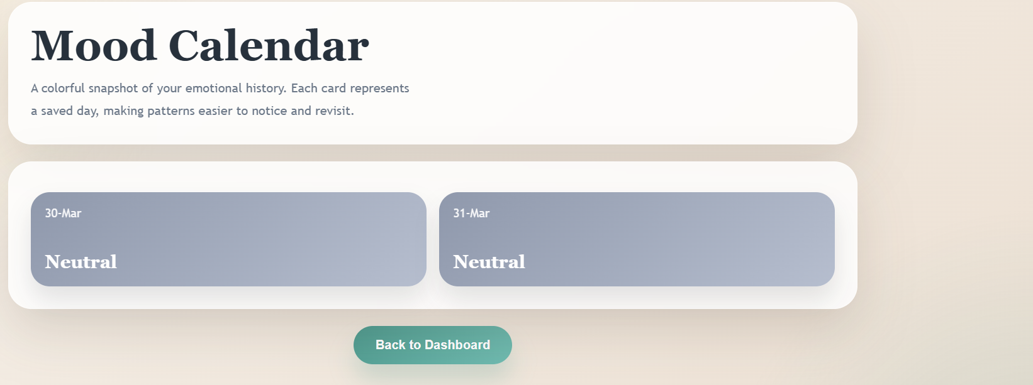
Mood Calendar:

Slide 37
Conclusion:
We developed an AI-based system that predicts user emotions from text using machine learning. The project includes model training, backend integration, user authentication, and mood-based recommendations. Some features are still under development, leaving scope for further improvements and enhancements.

